Slide 1

AtliQ Mart Analysis
Project Reports
By Vasudev Mogaveera

Slide 2
About Project
This project evaluates how well AtliQ Mart's branded products performed during the Diwali 2023 and Sankranti 2024 festive promotions.
AtliQ Mart is a large retail chain with over 50 supermarkets in southern India. The company wants to use data to improve future promotional strategies.
By analyzing sales and promotional activities, this study provides useful insights to help AtliQ Mart enhance its marketing efforts.

Slide 3
Ad-hoc — Requests Evaluation
AtliQ Mart's senior Team need SQL reports to answer business questions.

Slide 4

1. List products with a base price over 500 that are part of the 'BOGOF' (Buy One Get One Free) promotion.
This will help assess high-value discounts and refine pricing and promotion strategies.

Slide 5
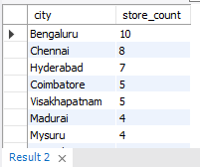
2. Generate a report showing the number of stores in each city, sorted in descending order.
The report will include city and store count to help optimize retail operations.

Slide 6
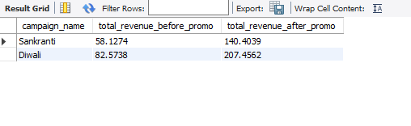
3. Generate a report showing each campaign's total revenue before and after the campaign (in millions)
to evaluate its financial impact. Fields: campaign_name, revenue_before, revenue_after.

Slide 7
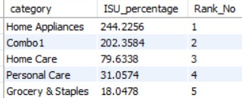
4. Generate a report calculating Incremental Sold Quantity (ISU%) for each category
during the Diwali campaign, ranking them by ISU%. Fields: category, ISU%, rank order.
This helps assess category-wise campaign impact.

Slide 8
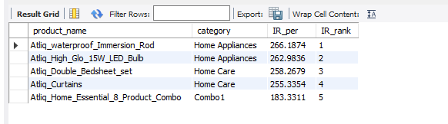
5. Generate a report of the Top 5 products ranked by Incremental Revenue Percentage
(IR%) across all campaigns. Fields: product name, category, IR%. This helps identify
top-performing products for optimization.

Slide 9
Key Business Insights
Store Performance Analysis :
Promotion Type Insights :
Product & Category Insights
Focus on High IR Categories: Prioritize categories like Combo, Grocery, Staples, and Home Appliances for
better revenue growth.
Target Top Cities: Concentrate on high-performing cities like Madurai, Chennai, and Bengaluru to maximize impact.
Use Effective Promotions: Promotions like ₹500 cashback and BOGOF drive strong sales and revenue.
Avoid Weak Discounts: Discounts like 25% OFF and 33% OFF are less effective in boosting revenue.
Optimize Festive Offers: Focus more on Diwali promotions, as they perform better than Sankranti deals.
Boost High-Growth Categories: Invest in top-performing categories like Home Appliances and Home Care.
Promote Best-Selling Products: Products like Atliq Waterproof Immersion Rod, Atliq LED Bulb, and Atliq
Double Bedsheet Set drive strong revenue.

Slide 10
Conclusion
Focusing on the best stores, successful promotions, and top-selling products helps boost sales and grow the business.
Using data to improve these areas ensures better use of resources, higher profits, and a stronger business.
It also sets the stage for future growth and market success.
In future Atliq Mart campaigns, we will not run 25% off and 33% off discounts as they do not generate sufficient revenue.
In the future, Atliq Mart will expand stores in high-revenue cities like Bangalore, Chennai, and Hyderabad.

Slide 11

Thank You

